Slide 1
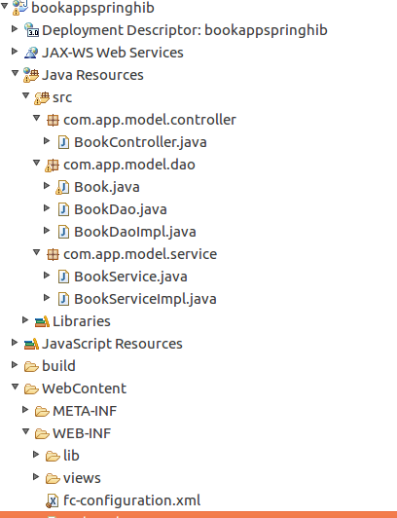
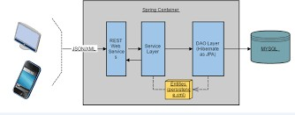



Slide 2
Step 1: DAO, DTO

Slide 3
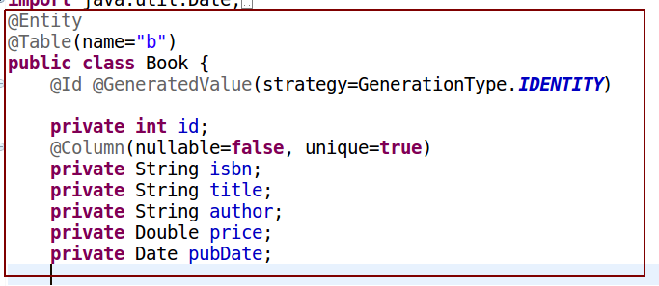
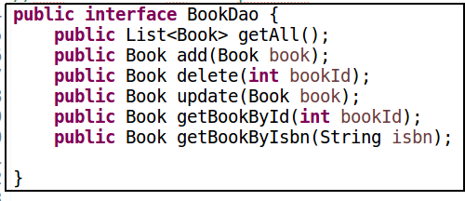
Dao Layer

Slide 4
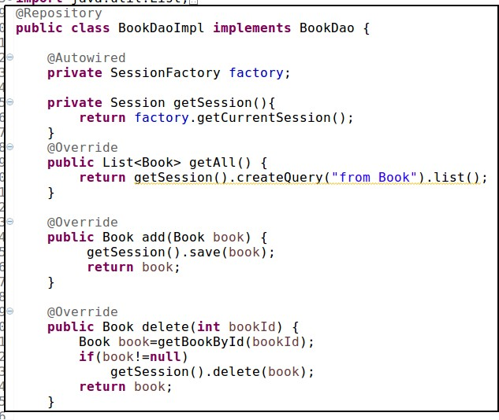
DaoImpl

Slide 5
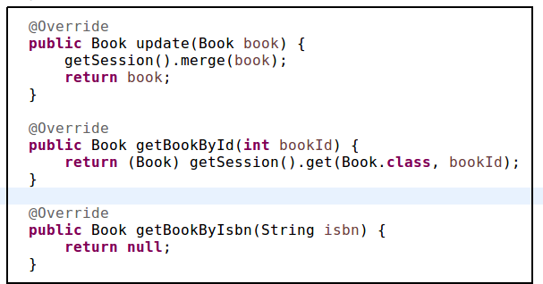
DaoImpl

Slide 6
Step 2: Service layer

Slide 7
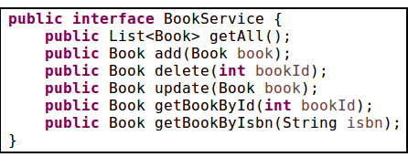
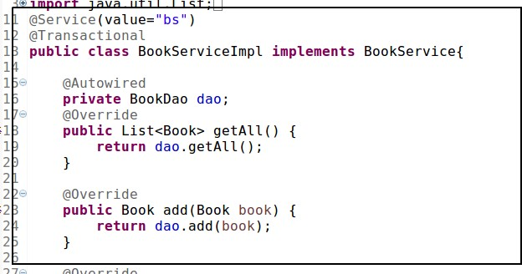
Service Layer

Slide 8
Step 3: Spring Hibernate Configuration

Slide 9
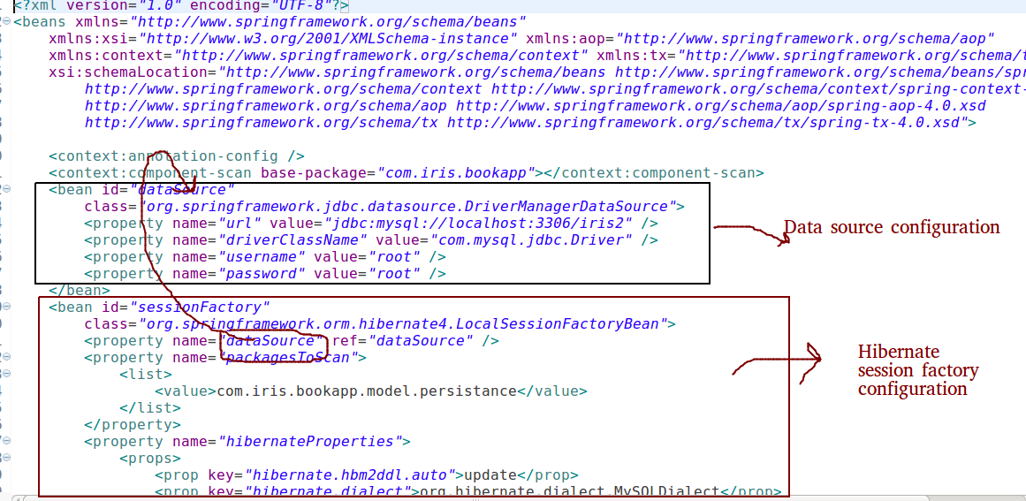
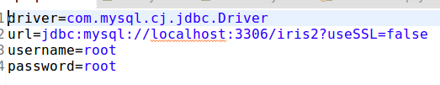
Configuration

Slide 10
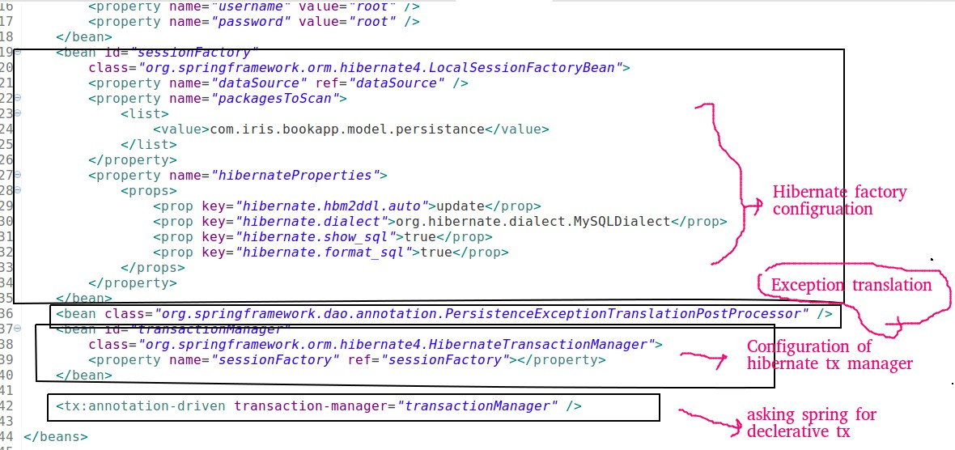
Configuration

Slide 11
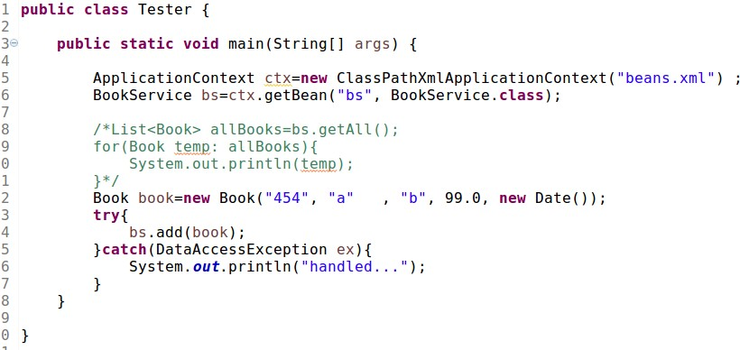
Testing

Slide 12
Step 4: Spring Hibernate Java Configuration

Slide 13
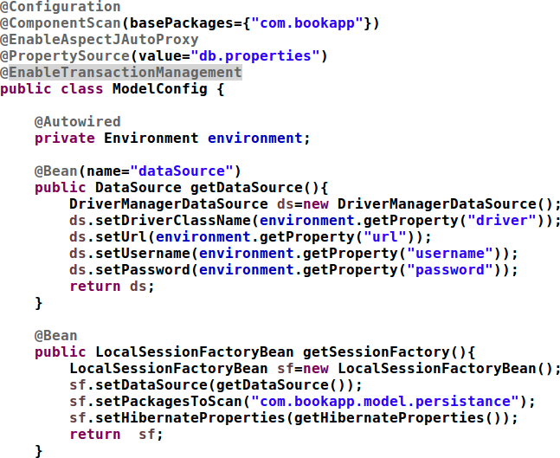

Slide 14
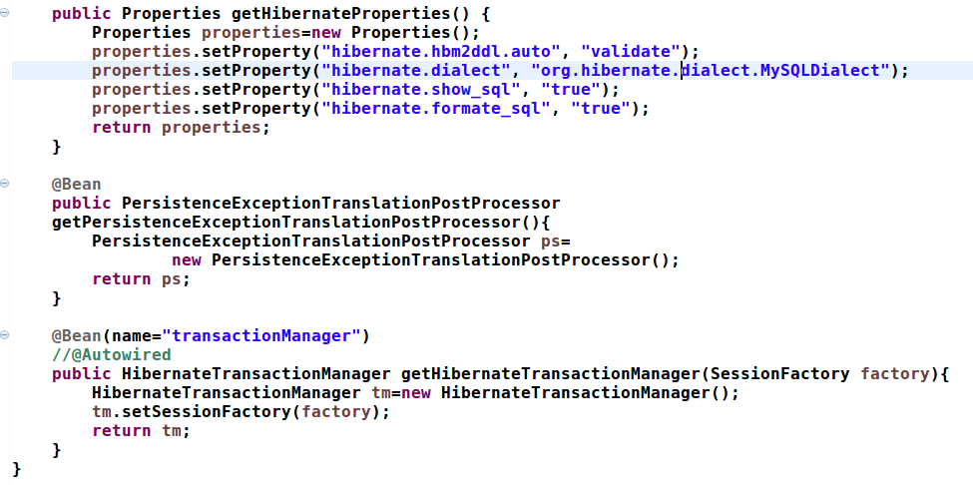

Slide 15
Step 5: Spring MVC basics

Slide 16
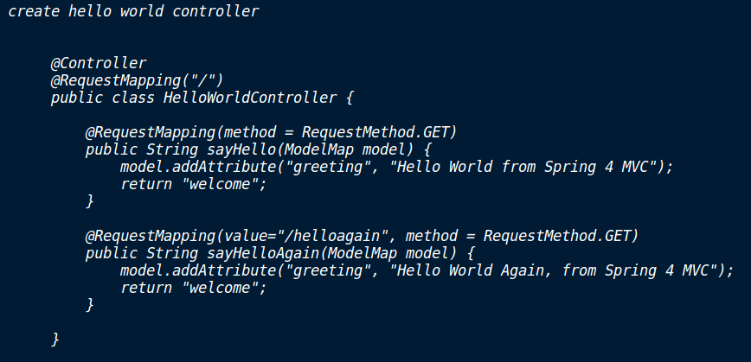
Hello world controller

Slide 17
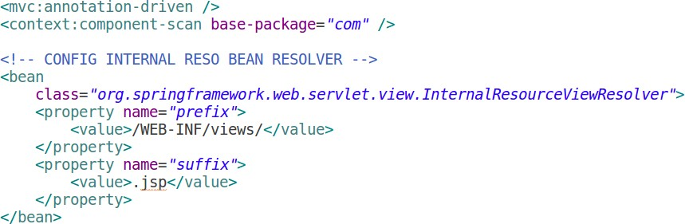
Web layer configuration

Slide 18
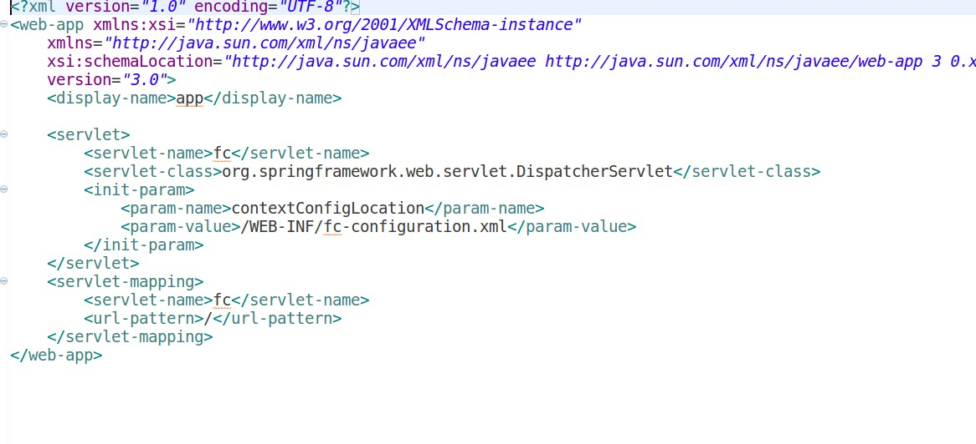
Front Controller Configuration

Slide 19
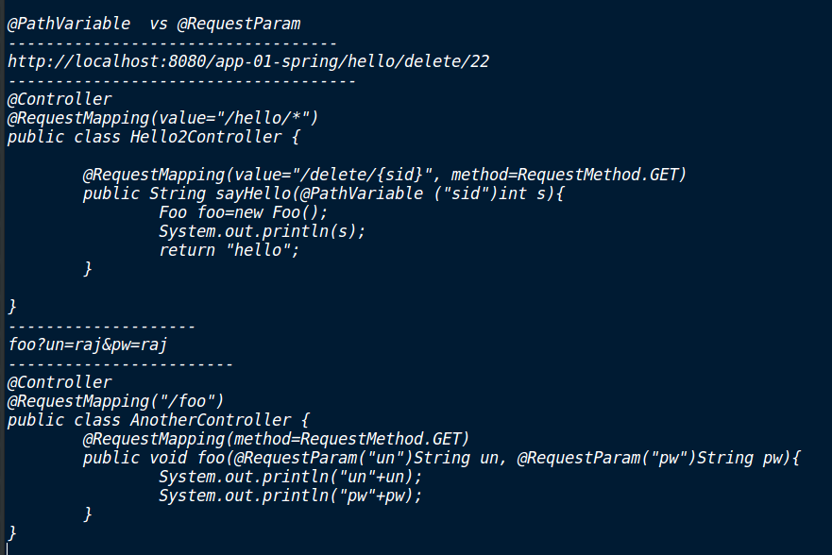

Slide 20
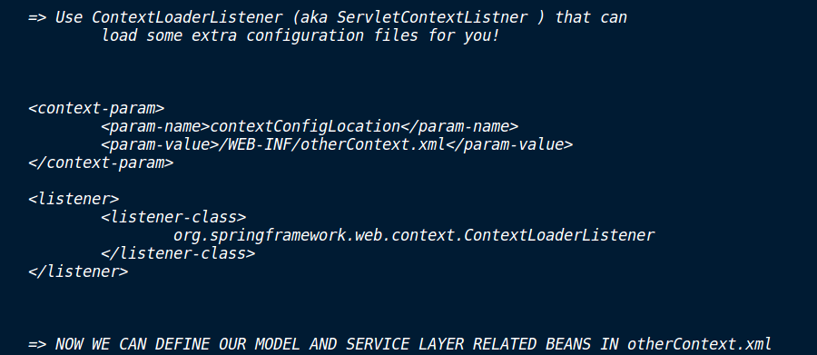
ContextLoaderListner

Slide 21
Step 6: Spring MVC java configuration

Slide 22
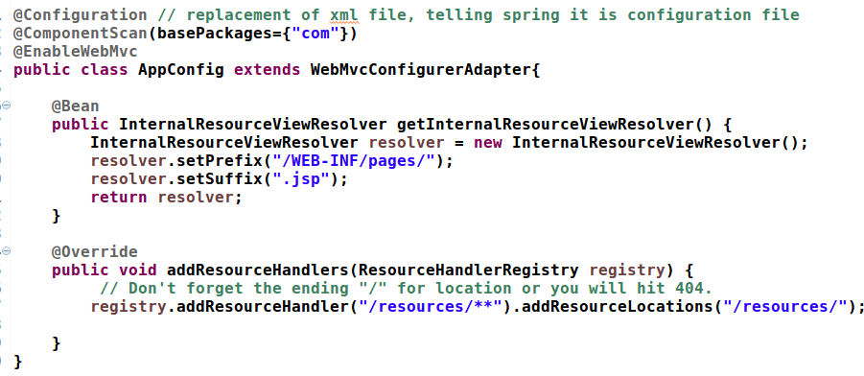

Slide 23
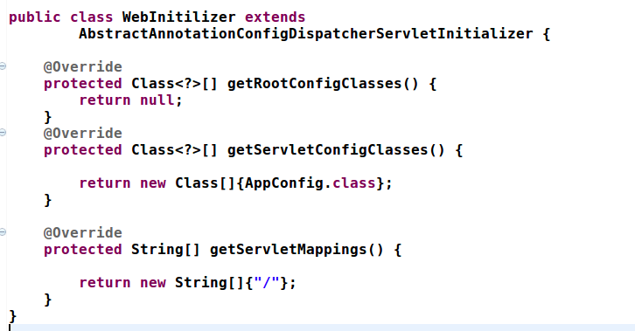

Slide 24
Step 7: Spring MVC, Hibernate

Slide 25
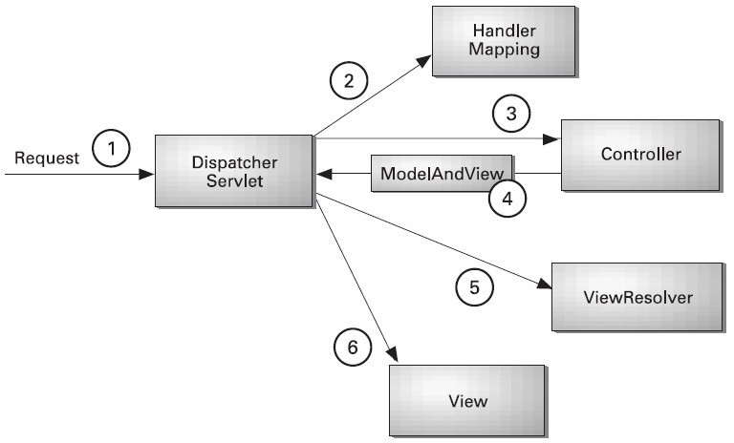

Slide 26
throws InterruptedException {
long base = System.currentTimeMillis(); //x long now = 0;
if (millis < 0) {
throw new IllegalArgumentException("timeout value is negative");
}
if (millis == 0) {
while (isAlive()) {
//case 1: 0 or nothing
wait(0);
}
} else {
while (isAlive()) {
long delay = millis - now; 700-0 if (delay <= 0) {
//+ve case
break;
x---x+1
}
wait(delay);
now = System.currentTimeMillis() - base;
}
}
Thread.currentThread.join(0); hread.currentThread.join();
hread.currentThread.join(700);

Slide 27
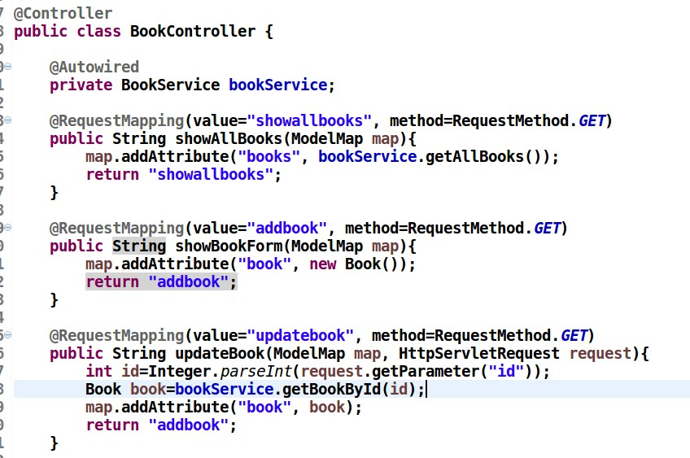

Slide 28
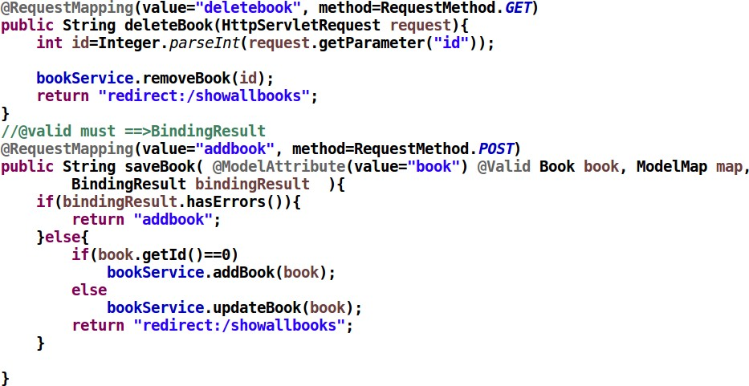

Slide 29
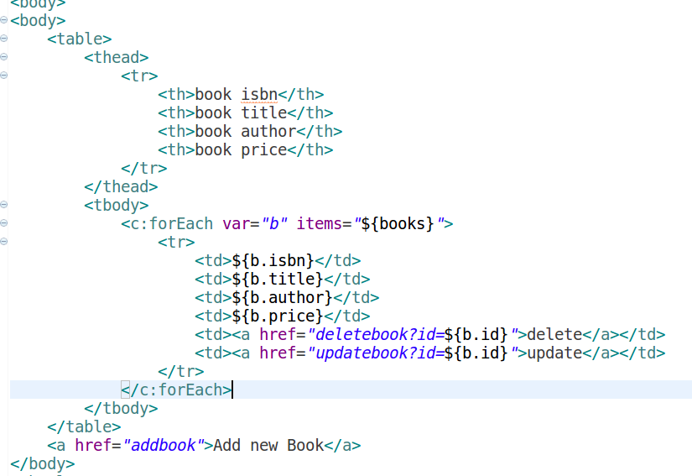
Display All Books

Slide 30
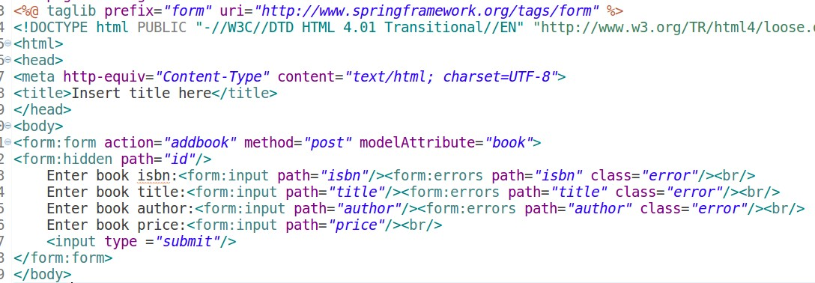
Add/ Edit a Book

Slide 31
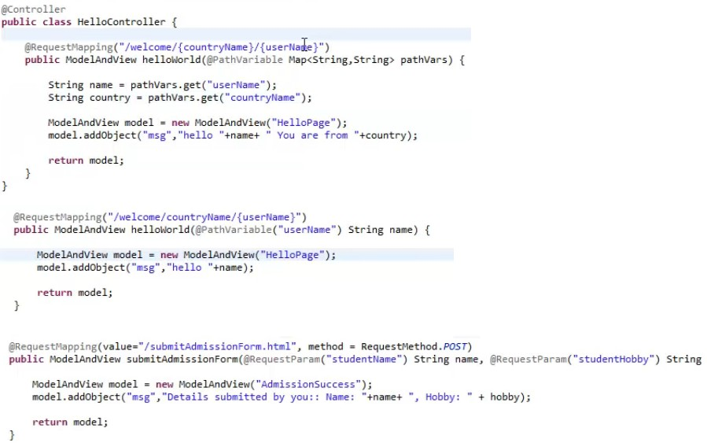

Slide 32
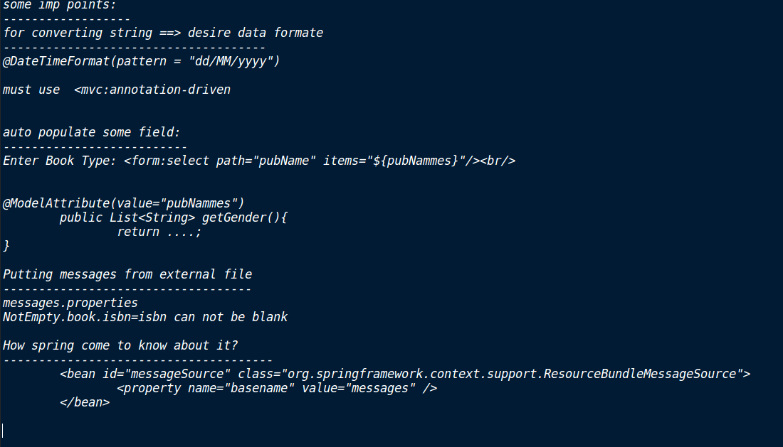

Slide 33
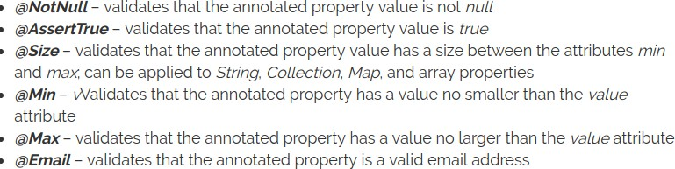
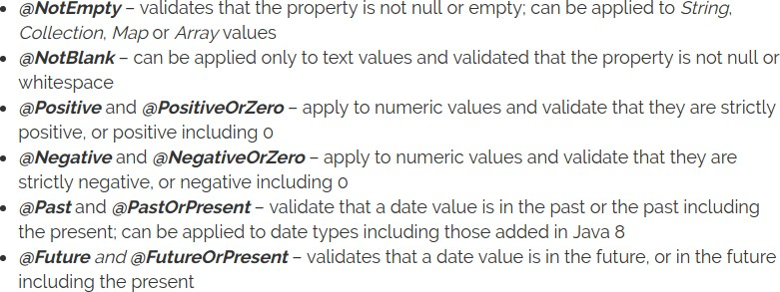
JSR 303 Validation API

Slide 34

8. Spring REST

Slide 35
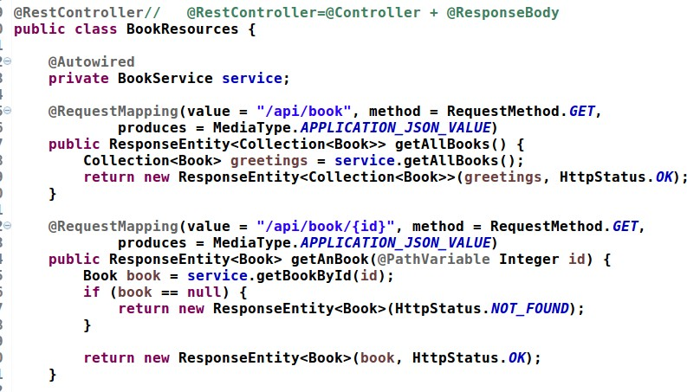

Slide 36
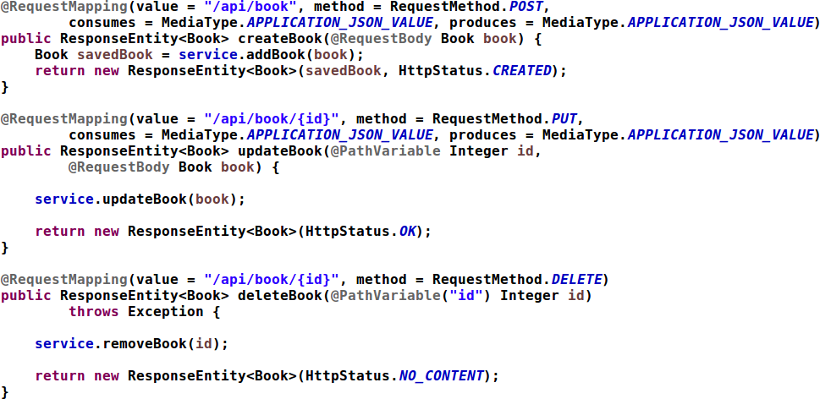

Slide 37
Step 9: Spring Hibernate Testing basics

Slide 38
